Slide 1

AWS Splunk Environments: A step by step guide to empowering collaborative community learning

Slide 2
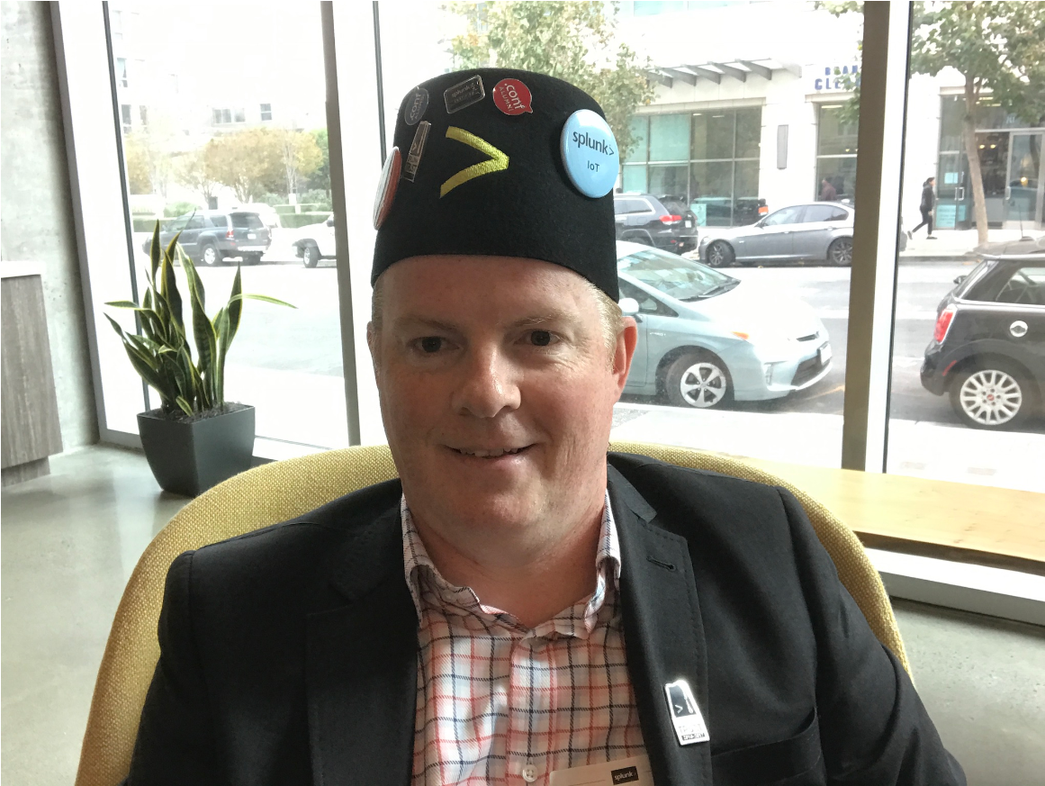


Your Presenters
Aleem Cummins Community Enablement Warrior
Independent
Suman Gajavelly CTO / Co-founder
BitsIO Inc
@aleemcummins https://www.linkedin.com/in/aleemcummins
SplunkTrust Splunk User Group London Splunk Study Club
@sumangajavelly https://www.linkedin.com/in/sumangajavelly
Fort Worth Splunk User Group
http://slack.splunkstudy.club
https://github.com/SplunkStudyClub

Slide 3
Session Agenda
AWS
Sign Up
Security
Instances
Access
Splunk
Deployment
Growth
Study Club
Keeping Lights On
DNS Scripts
Splunking DNS Logs
Lambda Functions

Slide 4

AWS Sign Up

Slide 5
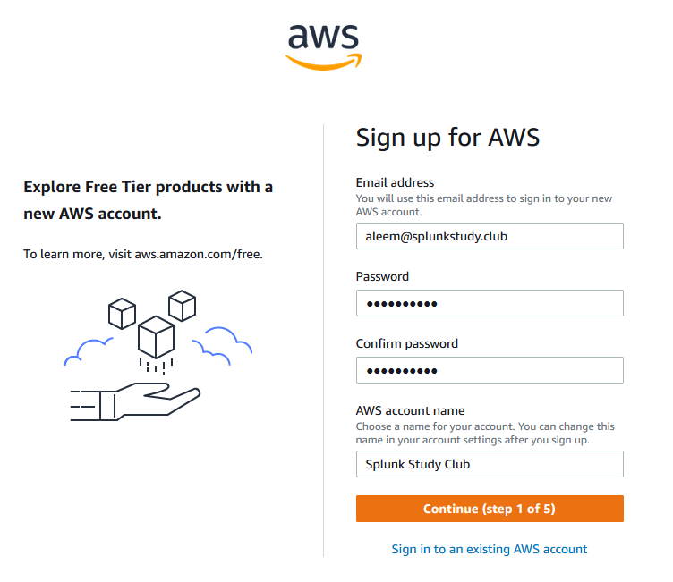
https://aws.amazon.com

Slide 6
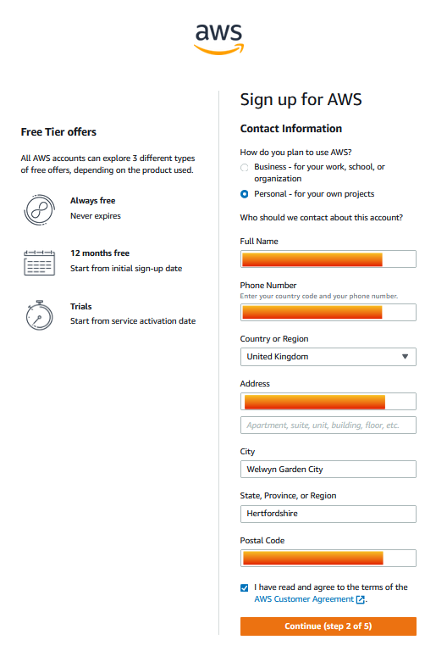
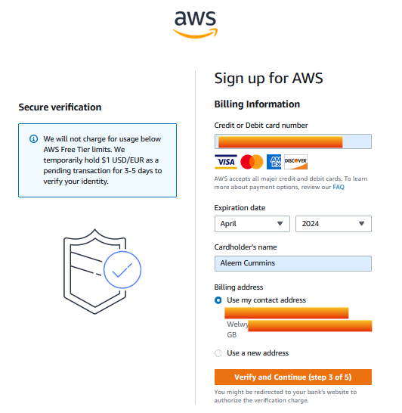

Slide 7
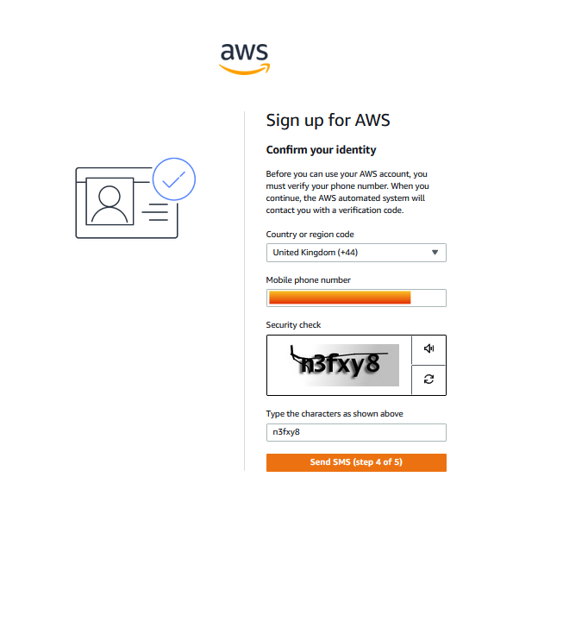
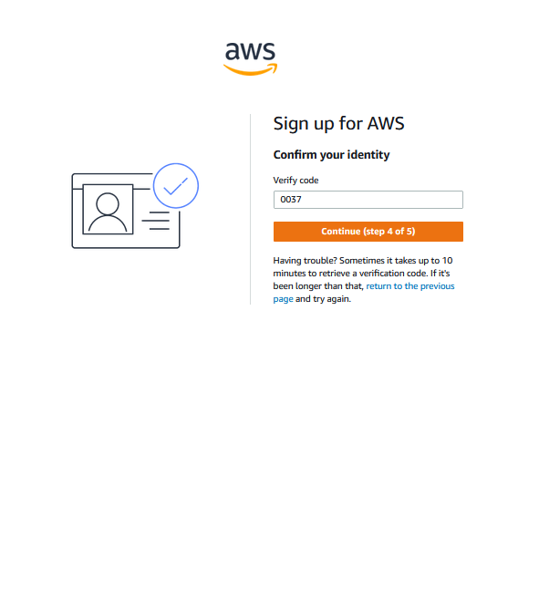

Slide 8
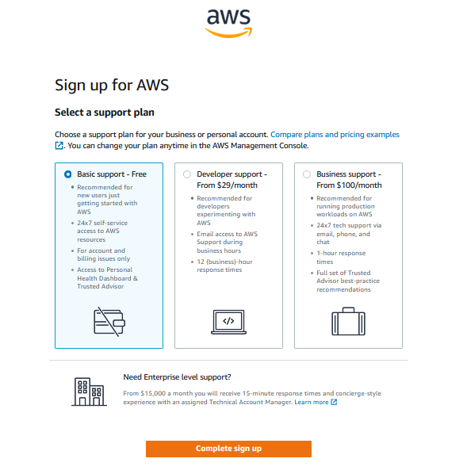
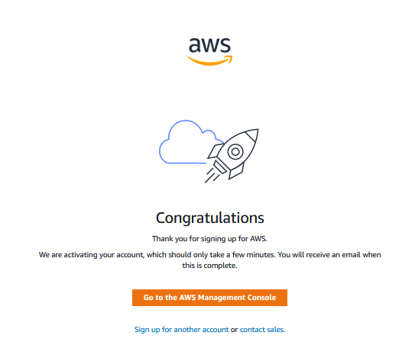

Slide 9
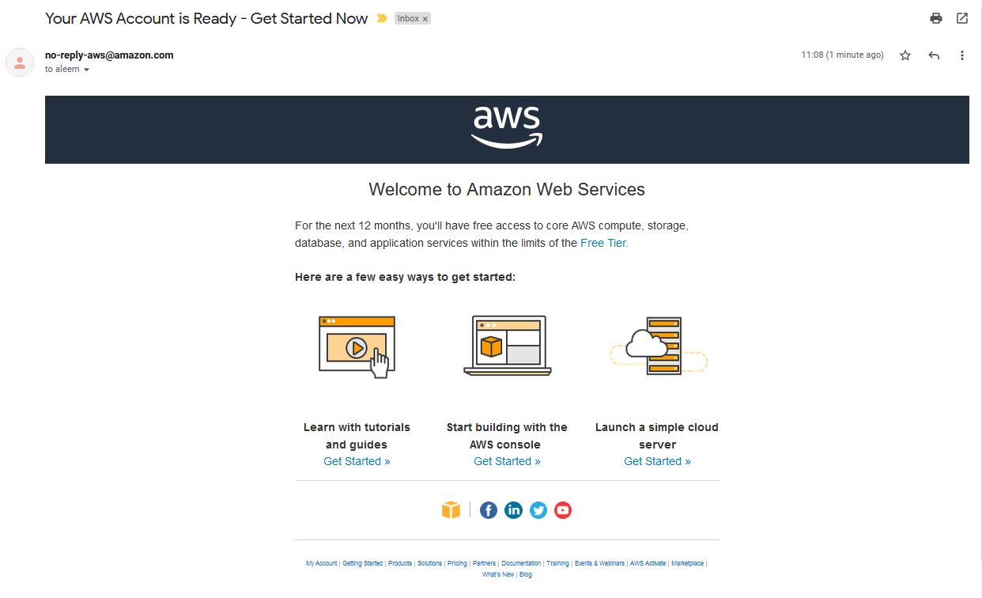
Wait for this email to come through

Slide 10
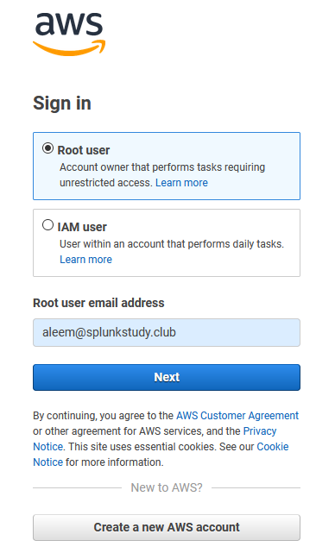
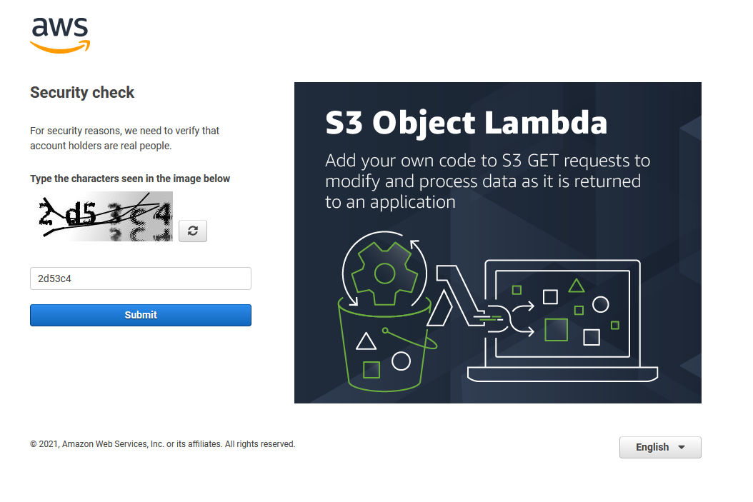
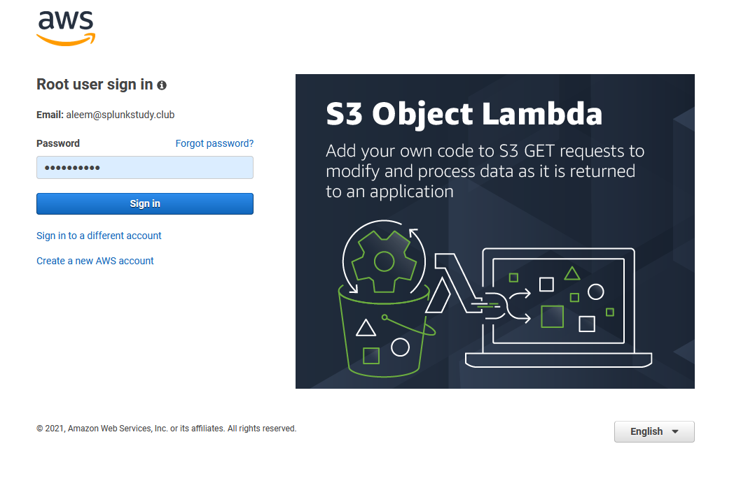
https://signin.aws.amazon.com/

Slide 11
AWS: Security SecurityGroups

Slide 12
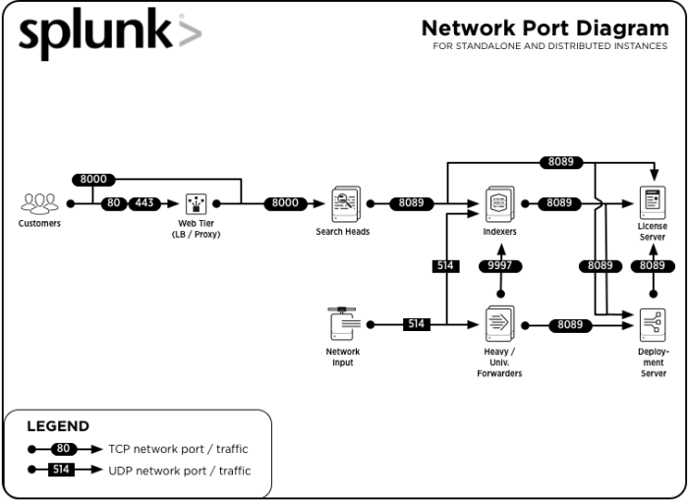
Splunk Enterprise Components: Network Connectivity
https://docs.splunk.com/Documentation/Splunk/8.1.3/InheritedDeployment/Ports

Slide 13
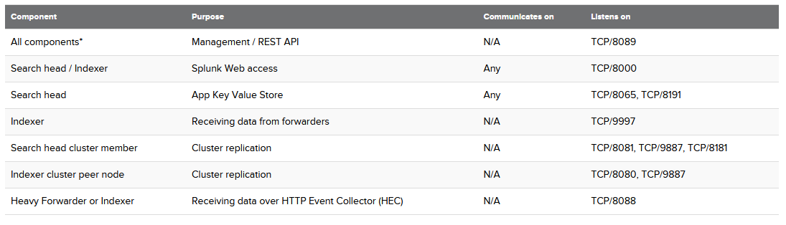
Splunk Enterprise Components: Network Connectivity
https://docs.splunk.com/Documentation/Splunk/8.1.3/InheritedDeployment/Ports

Slide 14
AWS SecurityGroup
Splunk Enterprise-8-1-3-AutogenByAWSMP
Default AWS Marketplace SecurityGroup based on recommended settings for Splunk Enterprise version 8.1.3 provided by Splunk
Inbound Rules
Outbound Rules
Type | Protocol | Port Range | Source
Custom TCP | TCP | 8000 | 0.0.0.0/0
Custom TCP | TCP | 554 | 0.0.0.0/0
SSH | TCP | 22 | 0.0.0.0/0
Custom TCP | TCP | 8089 | 0.0.0.0/0
Custom TCP | TCP | 9997 | 0.0.0.0/0
HTTPS | TCP | 443 | 0.0.0.0/0
Type | Protocol | Port Range | Destination
All Traffic | All | All | 0.0.0.0/0

Slide 15
All Splunk instances should be in same Security Group
AWS Security Group
Instances
https://docs.splunk.com/Documentation/Splunk/8.1.3/InheritedDeployment/Ports

Slide 16
AWS: Security Keys

Slide 17
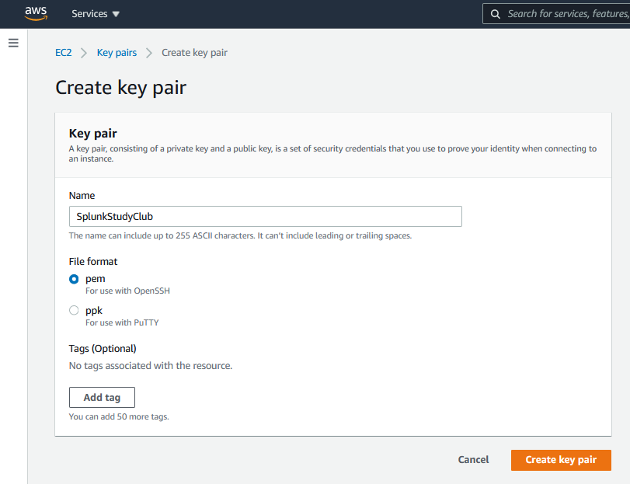
Create Key Pair
Only downloadable on creation. Keep safe!
Permissions on download
Permissions required

Slide 18
Create an Instance
Demo

Slide 19
AWS: Security Access

Slide 20
Accessing an AWS Instance
This will require an SSH client. Free examples include:
Name | OS | Download
PuTTY | Windows | https://www.putty.org
MobaXterm | Windows | https://mobaxterm.mobatek.net
Terminal | Mac | Built into Mac OS
iTerm2 | Mac | https://iterm2.com

Slide 21



Set Key Permissions
Permissions must be made restrictive to work with AWS via a SSH client
chmod 400 SplunkStudyClub.pem
Permissions on download
Permissions required
C:\restrict_pem_key.bat "c:\SplunkStudyClub.pem" "aleem"

Slide 22
AWS: Keeping lights on Updating DNS

Slide 23


DNS Outcome
Domain: SplunkStudy.Club
Goal: Enable dns management of subdomain via scripting Solve issue of non-static IP addressing for instances
Examples: sh01-ext.bsides.dns.splunkstudy.club 34.213.206.70
sh01-int.bsides.dns.splunkstudy.club 172.31.43.187
Action: Add DNS ns record to existing nameserver to delegate a subdomain to dynv6.com nameservers (dns.splunkstudy.club)
Type | Name | Value | TTL
NS | dns | ns1.dynv6.com | 1 Hour
NS | dns | ns2.dynv6.com | 1 Hour
NS | dns | ns3.dynv6.com | 1 Hour
xpac

Slide 24
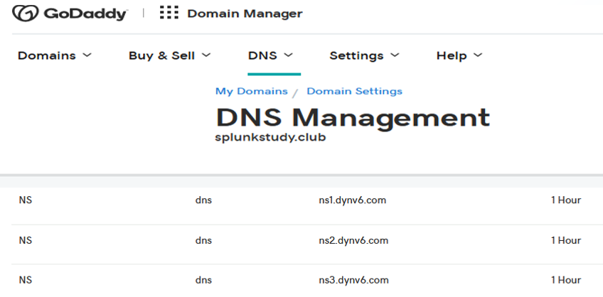
Subdomain Delegation

Slide 25
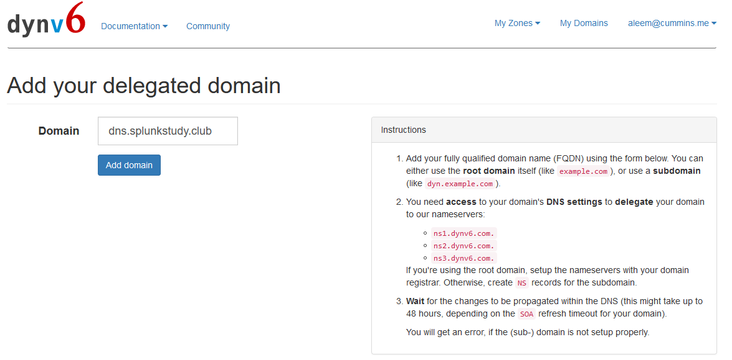
Delegated Domain Management

Slide 26
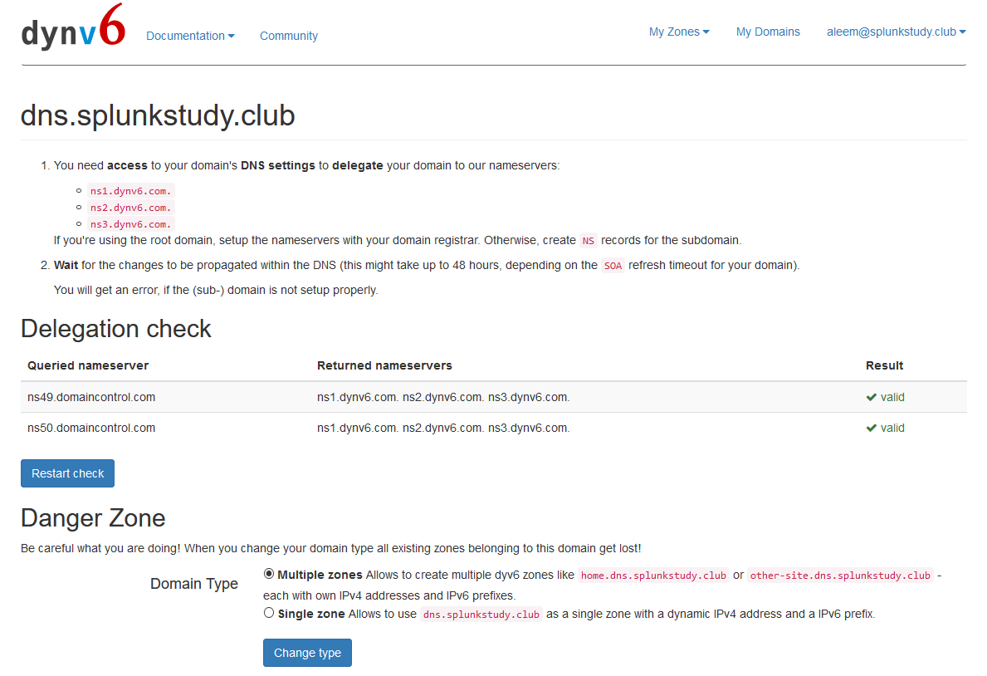
Delegated Domain Management

Slide 27
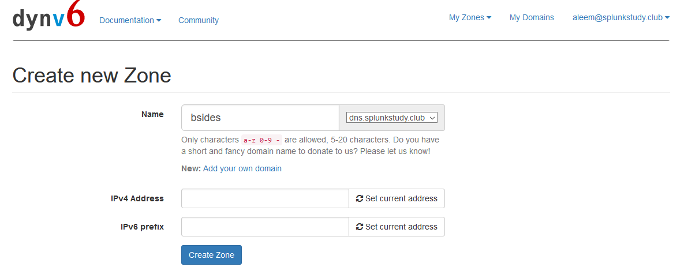
Adding DNS Zones

Slide 28
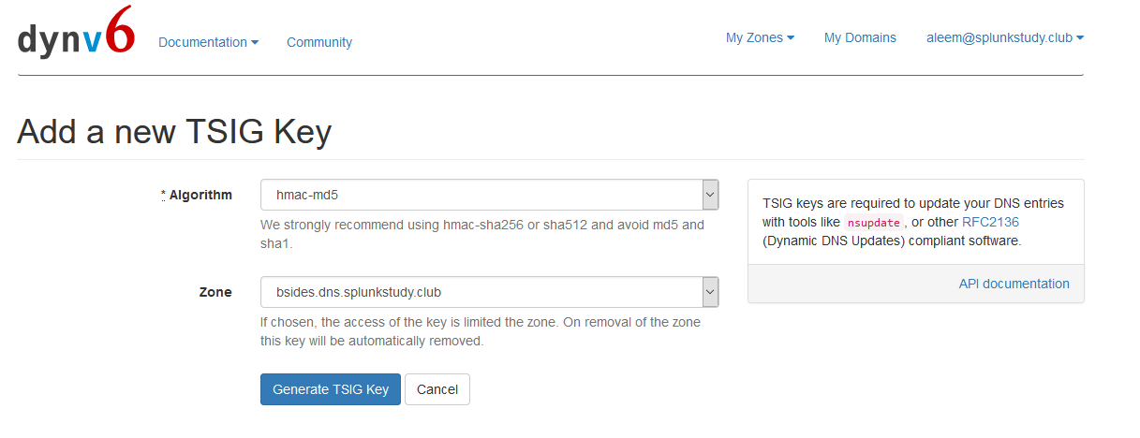
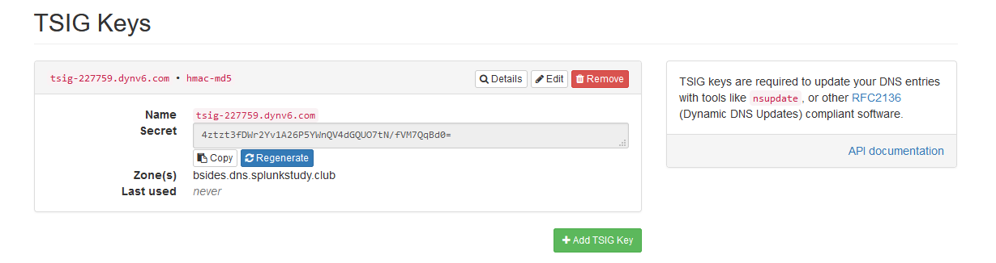
DNS Zone – Update Keys

Slide 29
DNS Update Commands
nsupdate
server ns1.dynv6.com
zone bsides.dns.splunkstudy.club
update delete sh100-int.bsides.dns.splunkstudy.club A
update add sh100-int.bsides.dns.splunkstudy.club 86400 A 172.31.8.205
update delete sh100-ext.bsides.dns.splunkstudy.club A
update add sh100-ext.bsides.dns.splunkstudy.club 86400 A 54.184.185.137
update delete i-0279ea465e401920f.bsides.dns.splunkstudy.club A
update add i-0279ea465e401920f.bsides.dns.splunkstudy.club 86400 A 54.184.185.137
key hmac-md5:tsig-227759.dynv6.com 4ztzt3fDWr2Yv1A26P5YWnQV4dGQUO7tN/fVM7QqBd0=
send

Slide 30
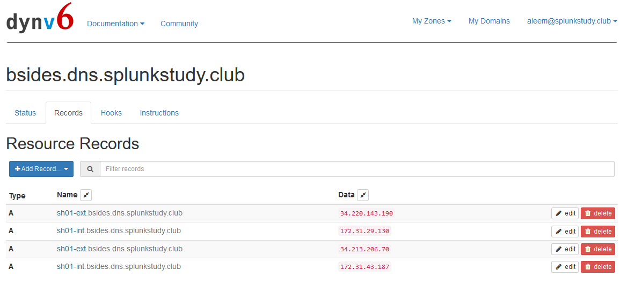
DNS Updates

Slide 31
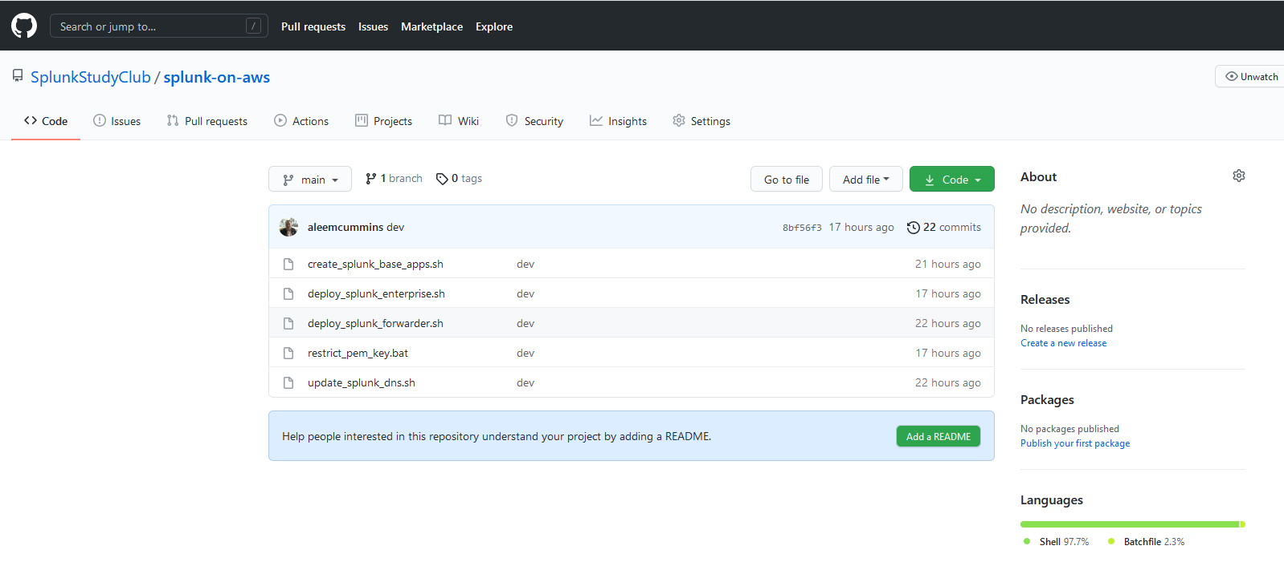
DNS Scripting - GitHub
https://github.com/SplunkStudyClub

Slide 32
DNS & Splunk Scripting
Getting host name for DNS updating
opt/splunk/etc/system/local/server.conf
[general]
serverName = sh01
grep serverName /opt/splunk/etc/system/local/server.conf | sed 's/[ ][ ]*//g' | cut -c 12- | sed -e 's/\(.*\)/\L\1/'
Getting internal server IP of instance for DNS updating
curl http://169.254.169.254/latest/meta-data/local-ipv4
Applying DNS settings
/opt/splunkforwarder/etc/system/local/deploymentclient.conf
[target-broker:deploymentServer]
targetUri = sh01-int.bsides.dns.splunkstudy.club:8089
Applied using base apps via deployment server
Plan ahead for your naming convention and instances!!

Slide 33
DNS Update Logs
UpdateTime=1618408851,AWS_INSTANCE_ID=i-0279ea465e401920f,DNS_SERVER=ns1.dynv6.com,Splunk_EXT_HOST=sh100-ext.bsides.dns.splunkstudy.club,Splunk_EXT_IP=34.221.89.29,Splunk_INT_HOST=sh100-int.bsides.dns.splunkstudy.club,Splunk_INT_IP=172.31.8.205,AWS_INSTANCE_ID_HOST=i-0279ea465e401920f.bsides.dns.splunkstudy.club,AWS_INSTANCE_ID_HOST_EXT_IP=34.221.89.29
UpdateTime=1618409104,AWS_INSTANCE_ID=i-0279ea465e401920f,DNS_SERVER=ns1.dynv6.com,Splunk_EXT_HOST=sh100-ext.bsides.dns.splunkstudy.club,Splunk_EXT_IP=34.221.89.29,Splunk_INT_HOST=sh100-int.bsides.dns.splunkstudy.club,Splunk_INT_IP=172.31.8.205,AWS_INSTANCE_ID_HOST=i-0279ea465e401920f.bsides.dns.splunkstudy.club,AWS_INSTANCE_ID_HOST_EXT_IP=34.221.89.29
UpdateTime=1618409405,AWS_INSTANCE_ID=i-0279ea465e401920f,DNS_SERVER=ns1.dynv6.com,Splunk_EXT_HOST=sh100-ext.bsides.dns.splunkstudy.club,Splunk_EXT_IP=34.221.89.29,Splunk_INT_HOST=sh100-int.bsides.dns.splunkstudy.club,Splunk_INT_IP=172.31.8.205,AWS_INSTANCE_ID_HOST=i-0279ea465e401920f.bsides.dns.splunkstudy.club,AWS_INSTANCE_ID_HOST_EXT_IP=34.221.89.29
UpdateTime=1618409705,AWS_INSTANCE_ID=i-0279ea465e401920f,DNS_SERVER=ns1.dynv6.com,Splunk_EXT_HOST=sh100-ext.bsides.dns.splunkstudy.club,Splunk_EXT_IP=34.221.89.29,Splunk_INT_HOST=sh100-int.bsides.dns.splunkstudy.club,Splunk_INT_IP=172.31.8.205,AWS_INSTANCE_ID_HOST=i-0279ea465e401920f.bsides.dns.splunkstudy.club,AWS_INSTANCE_ID_HOST_EXT_IP=34.221.89.29
UpdateTime=1618410005,AWS_INSTANCE_ID=i-0279ea465e401920f,DNS_SERVER=ns1.dynv6.com,Splunk_EXT_HOST=sh100-ext.bsides.dns.splunkstudy.club,Splunk_EXT_IP=34.221.89.29,Splunk_INT_HOST=sh100-int.bsides.dns.splunkstudy.club,Splunk_INT_IP=172.31.8.205,AWS_INSTANCE_ID_HOST=i-0279ea465e401920f.bsides.dns.splunkstudy.club,AWS_INSTANCE_ID_HOST_EXT_IP=34.221.89.29
UpdateTime=1618410304,AWS_INSTANCE_ID=i-0279ea465e401920f,DNS_SERVER=ns1.dynv6.com,Splunk_EXT_HOST=sh100-ext.bsides.dns.splunkstudy.club,Splunk_EXT_IP=34.221.89.29,Splunk_INT_HOST=sh100-int.bsides.dns.splunkstudy.club,Splunk_INT_IP=172.31.8.205,AWS_INSTANCE_ID_HOST=i-0279ea465e401920f.bsides.dns.splunkstudy.club,AWS_INSTANCE_ID_HOST_EXT_IP=34.221.89.29
UpdateTime=1618410607,AWS_INSTANCE_ID=i-0279ea465e401920f,DNS_SERVER=ns1.dynv6.com,Splunk_EXT_HOST=sh100-ext.bsides.dns.splunkstudy.club,Splunk_EXT_IP=34.221.89.29,Splunk_INT_HOST=sh100-int.bsides.dns.splunkstudy.club,Splunk_INT_IP=172.31.8.205,AWS_INSTANCE_ID_HOST=i-0279ea465e401920f.bsides.dns.splunkstudy.club,AWS_INSTANCE_ID_HOST_EXT_IP=34.221.89.29
UpdateTime=1618410904,AWS_INSTANCE_ID=i-0279ea465e401920f,DNS_SERVER=ns1.dynv6.com,Splunk_EXT_HOST=sh100-ext.bsides.dns.splunkstudy.club,Splunk_EXT_IP=34.221.89.29,Splunk_INT_HOST=sh100-int.bsides.dns.splunkstudy.club,Splunk_INT_IP=172.31.8.205,AWS_INSTANCE_ID_HOST=i-0279ea465e401920f.bsides.dns.splunkstudy.club,AWS_INSTANCE_ID_HOST_EXT_IP=34.221.89.29

Slide 34
Accessing an Instance Deploying Splunk
Demo

Slide 35
Onboarding DNS Logs
Demo

Slide 36
Onboarding DNS Update Logs
UpdateTime=1618408851,AWS_INSTANCE_ID=i-0279ea465e401920f,DNS_SERVER=ns1.dynv6.com,Splunk_EXT_HOST=sh100-ext.bsides.dns.splunkstudy.club,Splunk_EXT_IP=34.221.89.29,Splunk_INT_HOST=sh100-int.bsides.dns.splunkstudy.club,Splunk_INT_IP=172.31.8.205,AWS_INSTANCE_ID_HOST=i-0279ea465e401920f.bsides.dns.splunkstudy.club,AWS_INSTANCE_ID_HOST_EXT_IP=34.221.89.29
UpdateTime=1618409104,AWS_INSTANCE_ID=i-0279ea465e401920f,DNS_SERVER=ns1.dynv6.com,Splunk_EXT_HOST=sh100-ext.bsides.dns.splunkstudy.club,Splunk_EXT_IP=34.221.89.29,Splunk_INT_HOST=sh100-int.bsides.dns.splunkstudy.club,Splunk_INT_IP=172.31.8.205,AWS_INSTANCE_ID_HOST=i-0279ea465e401920f.bsides.dns.splunkstudy.club,AWS_INSTANCE_ID_HOST_EXT_IP=34.221.89.29
UpdateTime=1618409405,AWS_INSTANCE_ID=i-0279ea465e401920f,DNS_SERVER=ns1.dynv6.com,Splunk_EXT_HOST=sh100-ext.bsides.dns.splunkstudy.club,Splunk_EXT_IP=34.221.89.29,Splunk_INT_HOST=sh100-int.bsides.dns.splunkstudy.club,Splunk_INT_IP=172.31.8.205,AWS_INSTANCE_ID_HOST=i-0279ea465e401920f.bsides.dns.splunkstudy.club,AWS_INSTANCE_ID_HOST_EXT_IP=34.221.89.29
UpdateTime=1618409705,AWS_INSTANCE_ID=i-0279ea465e401920f,DNS_SERVER=ns1.dynv6.com,Splunk_EXT_HOST=sh100-ext.bsides.dns.splunkstudy.club,Splunk_EXT_IP=34.221.89.29,Splunk_INT_HOST=sh100-int.bsides.dns.splunkstudy.club,Splunk_INT_IP=172.31.8.205,AWS_INSTANCE_ID_HOST=i-0279ea465e401920f.bsides.dns.splunkstudy.club,AWS_INSTANCE_ID_HOST_EXT_IP=34.221.89.29
UpdateTime=1618410005,AWS_INSTANCE_ID=i-0279ea465e401920f,DNS_SERVER=ns1.dynv6.com,Splunk_EXT_HOST=sh100-ext.bsides.dns.splunkstudy.club,Splunk_EXT_IP=34.221.89.29,Splunk_INT_HOST=sh100-int.bsides.dns.splunkstudy.club,Splunk_INT_IP=172.31.8.205,AWS_INSTANCE_ID_HOST=i-0279ea465e401920f.bsides.dns.splunkstudy.club,AWS_INSTANCE_ID_HOST_EXT_IP=34.221.89.29
UpdateTime=1618410304,AWS_INSTANCE_ID=i-0279ea465e401920f,DNS_SERVER=ns1.dynv6.com,Splunk_EXT_HOST=sh100-ext.bsides.dns.splunkstudy.club,Splunk_EXT_IP=34.221.89.29,Splunk_INT_HOST=sh100-int.bsides.dns.splunkstudy.club,Splunk_INT_IP=172.31.8.205,AWS_INSTANCE_ID_HOST=i-0279ea465e401920f.bsides.dns.splunkstudy.club,AWS_INSTANCE_ID_HOST_EXT_IP=34.221.89.29
UpdateTime=1618410607,AWS_INSTANCE_ID=i-0279ea465e401920f,DNS_SERVER=ns1.dynv6.com,Splunk_EXT_HOST=sh100-ext.bsides.dns.splunkstudy.club,Splunk_EXT_IP=34.221.89.29,Splunk_INT_HOST=sh100-int.bsides.dns.splunkstudy.club,Splunk_INT_IP=172.31.8.205,AWS_INSTANCE_ID_HOST=i-0279ea465e401920f.bsides.dns.splunkstudy.club,AWS_INSTANCE_ID_HOST_EXT_IP=34.221.89.29
UpdateTime=1618410904,AWS_INSTANCE_ID=i-0279ea465e401920f,DNS_SERVER=ns1.dynv6.com,Splunk_EXT_HOST=sh100-ext.bsides.dns.splunkstudy.club,Splunk_EXT_IP=34.221.89.29,Splunk_INT_HOST=sh100-int.bsides.dns.splunkstudy.club,Splunk_INT_IP=172.31.8.205,AWS_INSTANCE_ID_HOST=i-0279ea465e401920f.bsides.dns.splunkstudy.club,AWS_INSTANCE_ID_HOST_EXT_IP=34.221.89.29

Slide 37
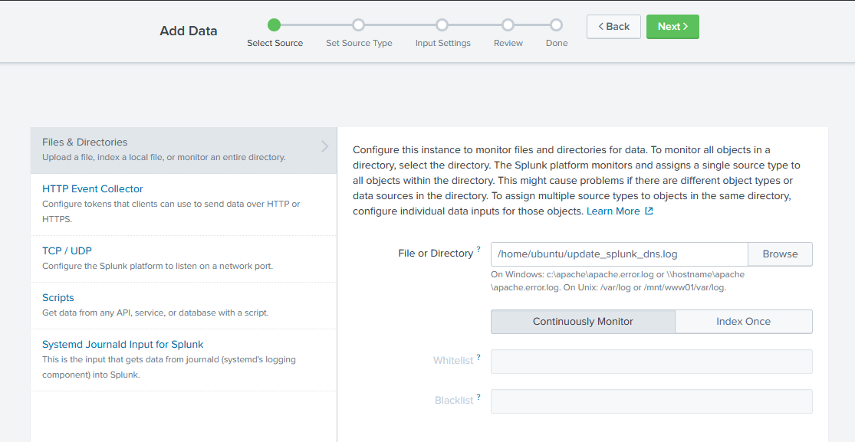
Onboarding DNS Update Logs

Slide 38
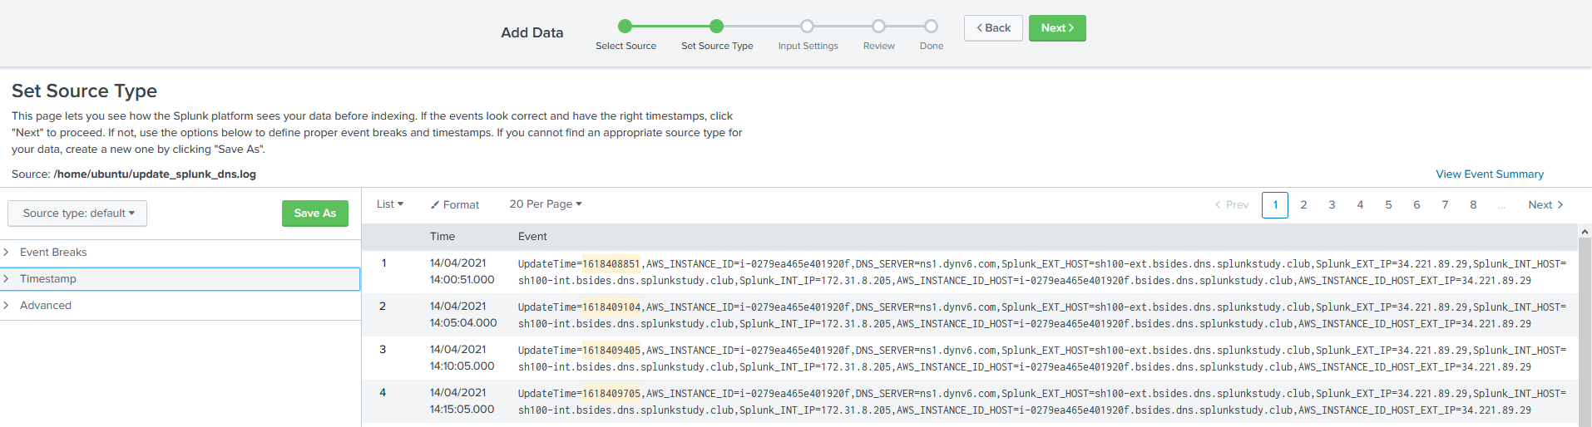
Onboarding DNS Update Logs

Slide 39
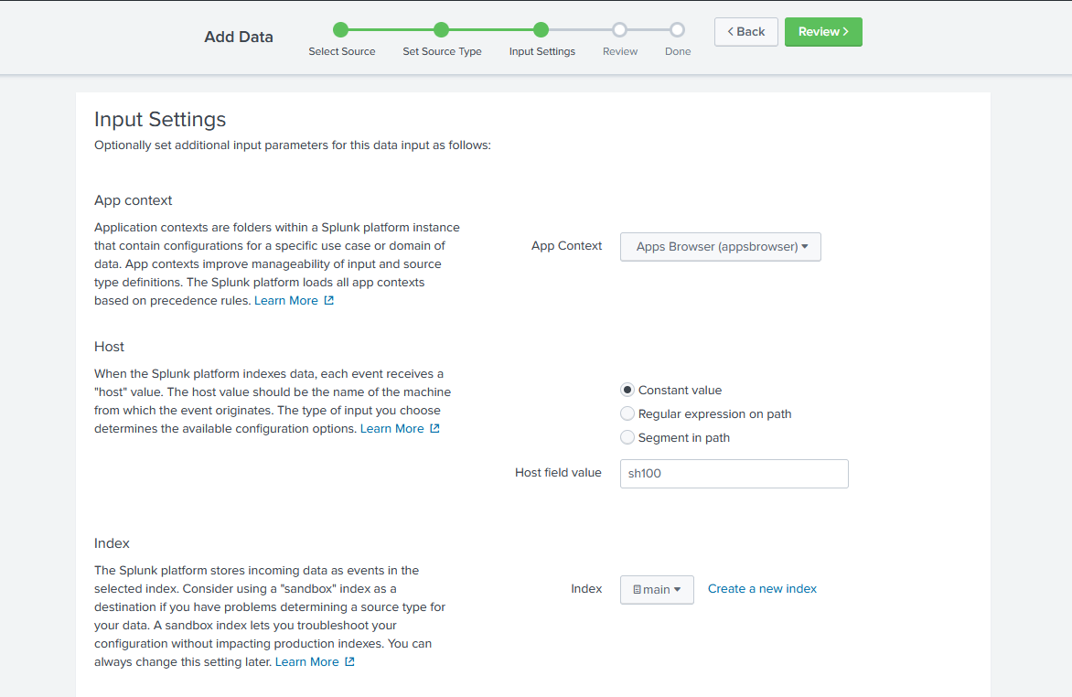
Onboarding DNS Update Logs

Slide 40
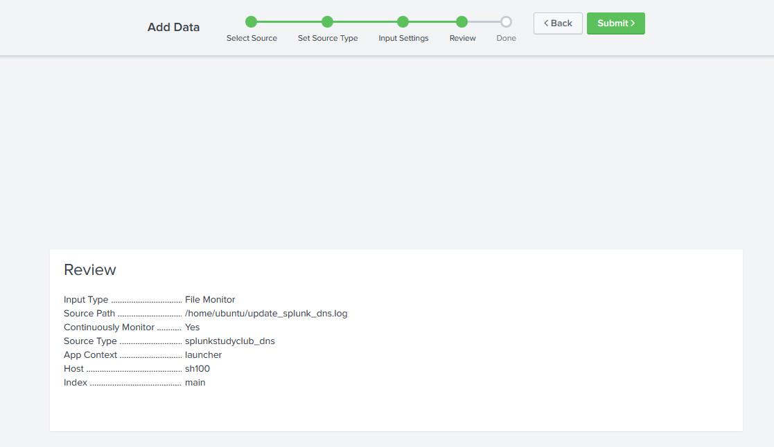
Onboarding DNS Update Logs

Slide 41
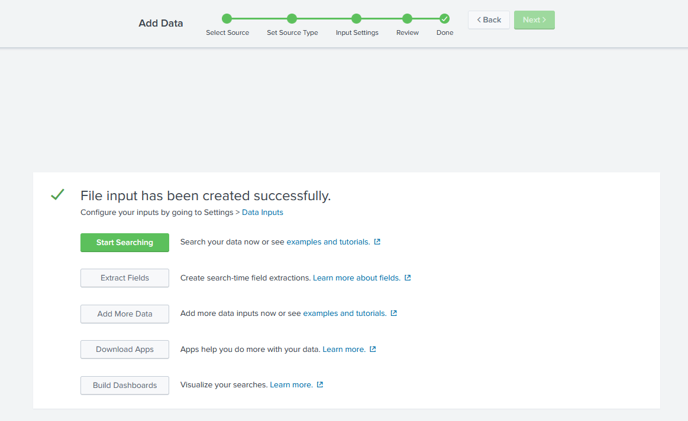
Onboarding DNS Update Logs

Slide 42
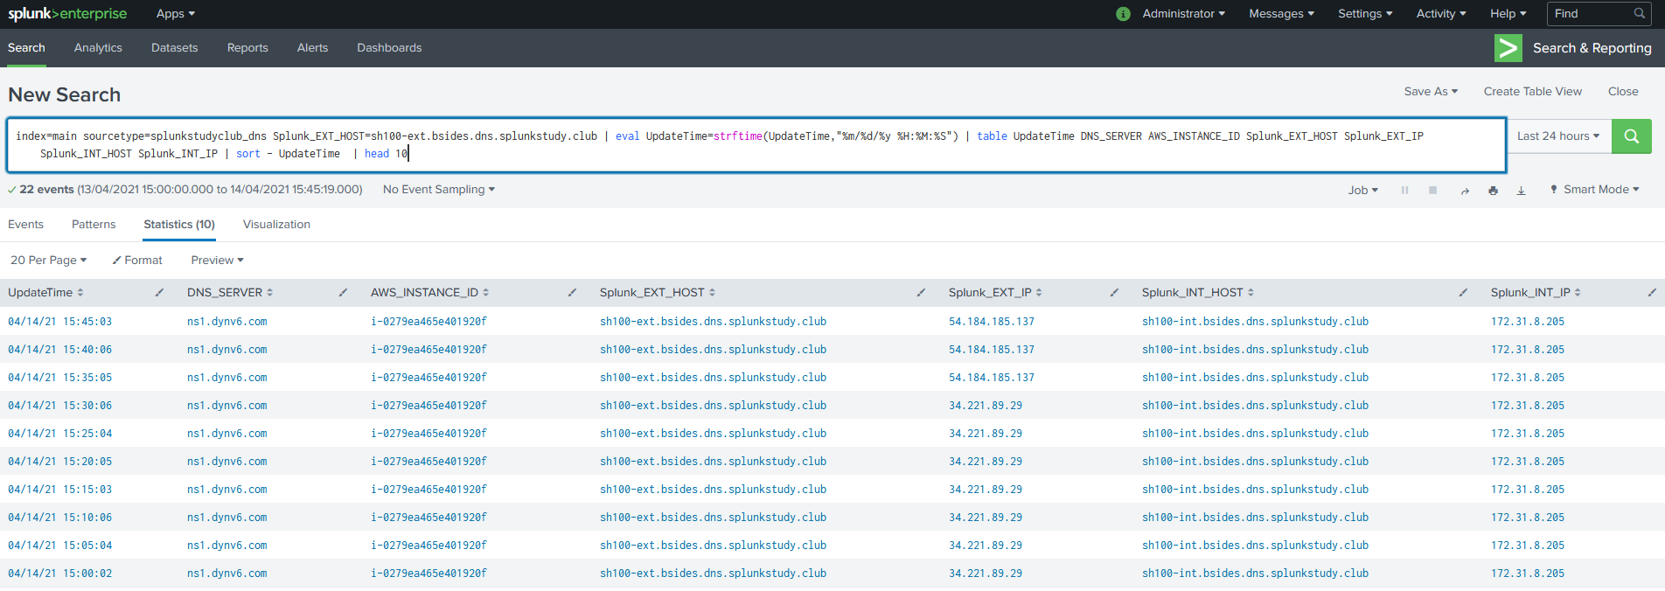
Working with DNS Update Logs
index=main sourcetype=splunkstudyclub_dns | eval UpdateTime=strftime(UpdateTime,"%m/%d/%y %H:%M:%S") | table UpdateTime DNS_SERVER AWS_INSTANCE_ID Splunk_EXT_HOST Splunk_EXT_IP Splunk_INT_HOST Splunk_INT_IP | sort - UpdateTime | head 10
index=main sourcetype=splunkstudyclub_dns | dedup AWS_INSTANCE_ID | eval UpdateTime=strftime(UpdateTime,"%m/%d/%y %H:%M:%S") | table UpdateTime DNS_SERVER AWS_INSTANCE_ID Splunk_EXT_HOST Splunk_EXT_IP Splunk_INT_HOST Splunk_INT_IP | sort - UpdateTime | head 10

Slide 43

AWS: Keeping lights on Minimising Costs
jkat54

Slide 44
Lambda Functions - Concept
Started
Stopped
https://aws.amazon.com/premiumsupport/knowledge-center/start-stop-lambda-cloudwatch/

Slide 45
Lambda Functions - Serverless
SplunkStudyClub
Start
Started
Stop
Stopped
https://aws.amazon.com/premiumsupport/knowledge-center/start-stop-lambda-cloudwatch/

Slide 46
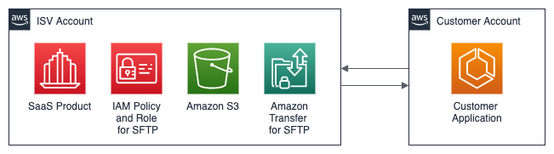
Lambda Function - Permissions
SplunkStudyClub
Start
Started
Stop
Stopped
AWS Identity and Access Management (IAM)
https://aws.amazon.com/premiumsupport/knowledge-center/start-stop-lambda-cloudwatch/

Slide 47
To control AWS Instance state
Create an AWS Identity and Access Management (IAM) policy and role
Create Lambda function to stop EC2 instances using this new policy and role
Create Lambda function to start EC2 instances using this new policy and role
Expose Lambda functions via the AWS API Gateway
Lambda Function Stop Instances
IAM Policy
and Role
AWS API Gateway
Lambda Function Start Instances
https://aws.amazon.com/premiumsupport/knowledge-center/start-stop-lambda-cloudwatch/

Slide 48
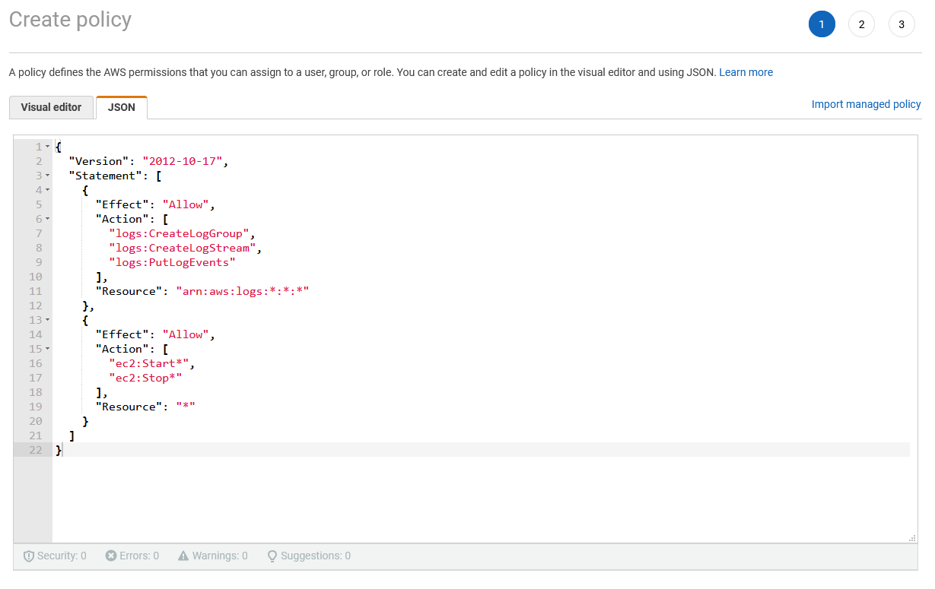
IAM Policy
and Role

Slide 49
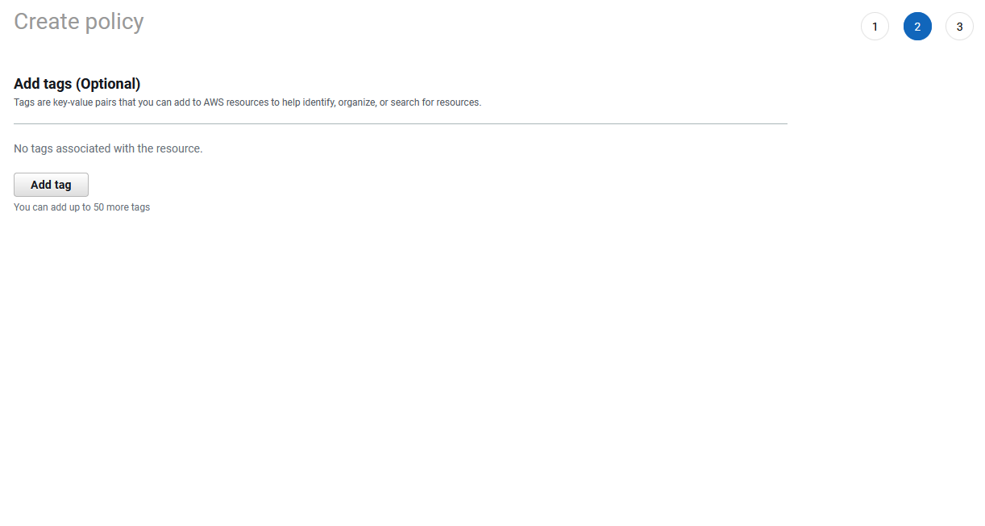
IAM Policy
and Role

Slide 50
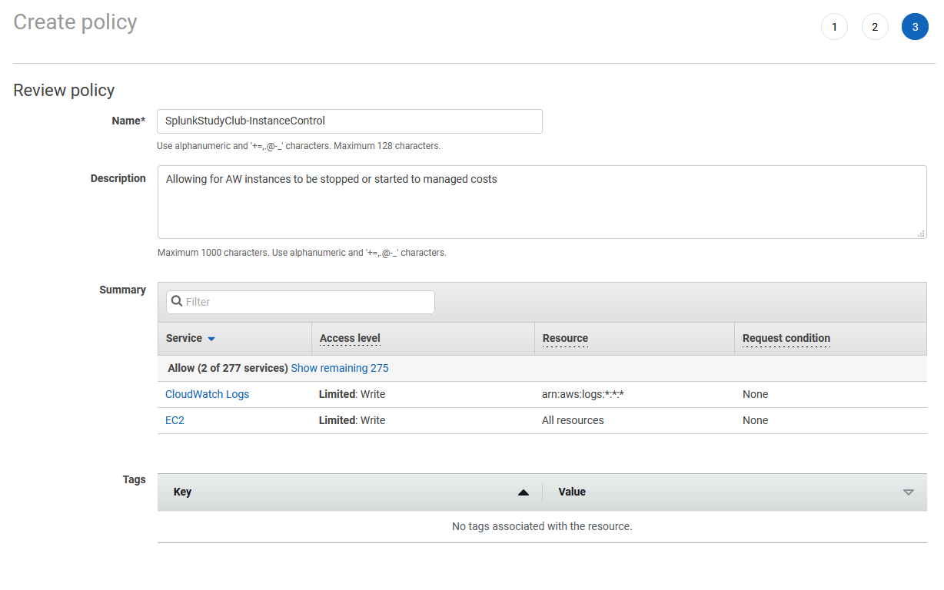
IAM Policy
and Role

Slide 51
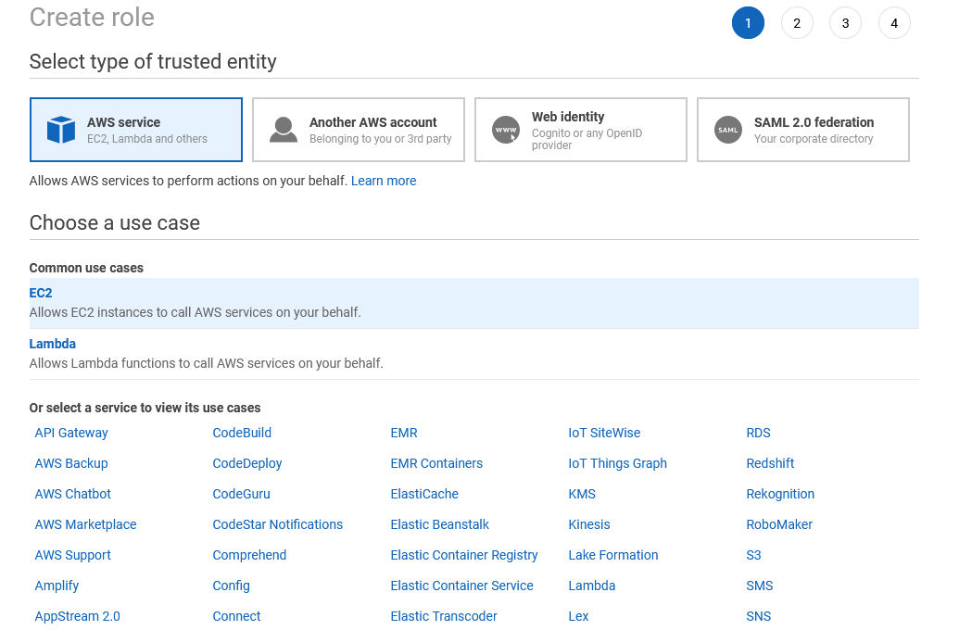
IAM Policy
and Role

Slide 52
IAM Policy
and Role

Slide 53
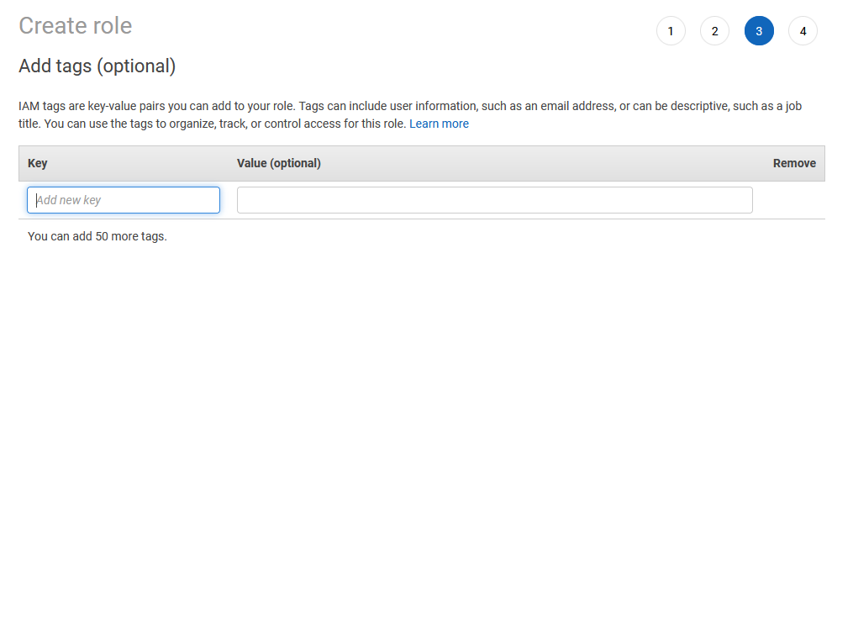
IAM Policy
and Role

Slide 54
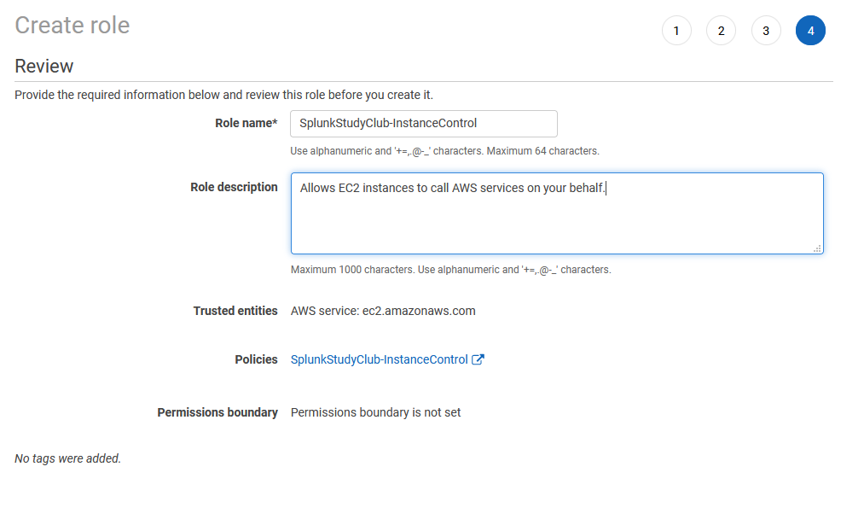
IAM Policy
and Role

Slide 55
IAM Policy
and Role

Slide 56
Lambda Function

Slide 57
Lambda Function

Slide 58
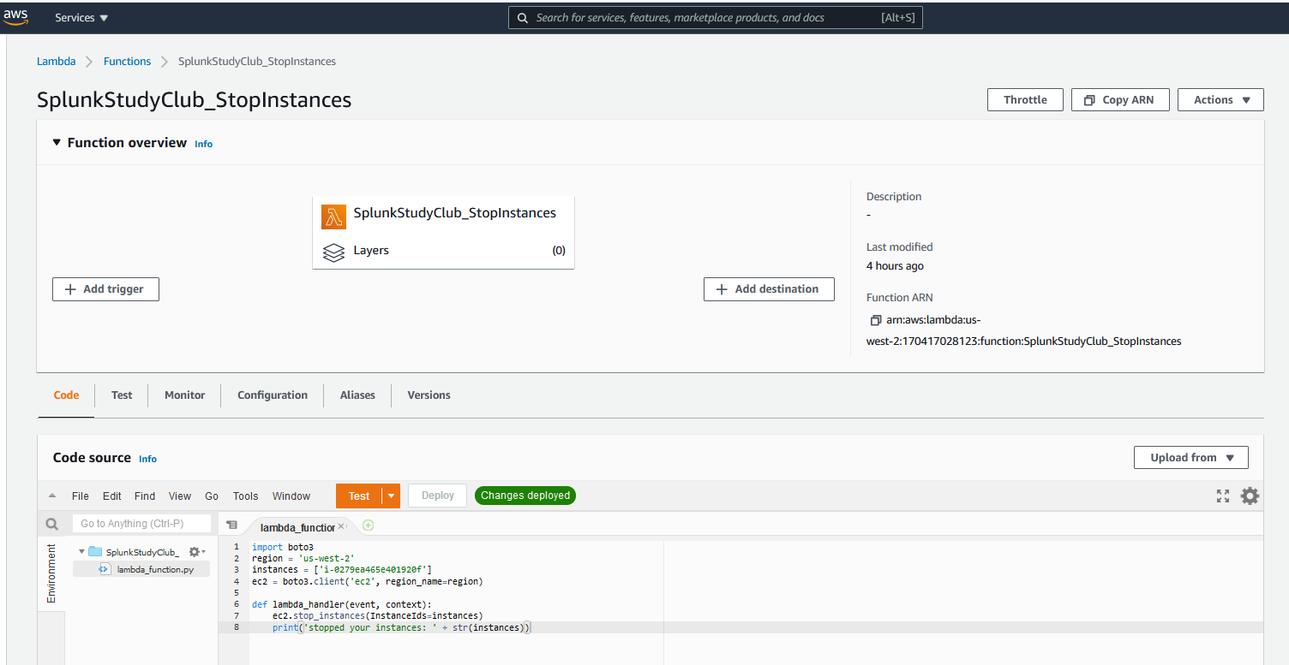
Lambda Function
https://aws.amazon.com/premiumsupport/knowledge-center/start-stop-lambda-cloudwatch/

Slide 59
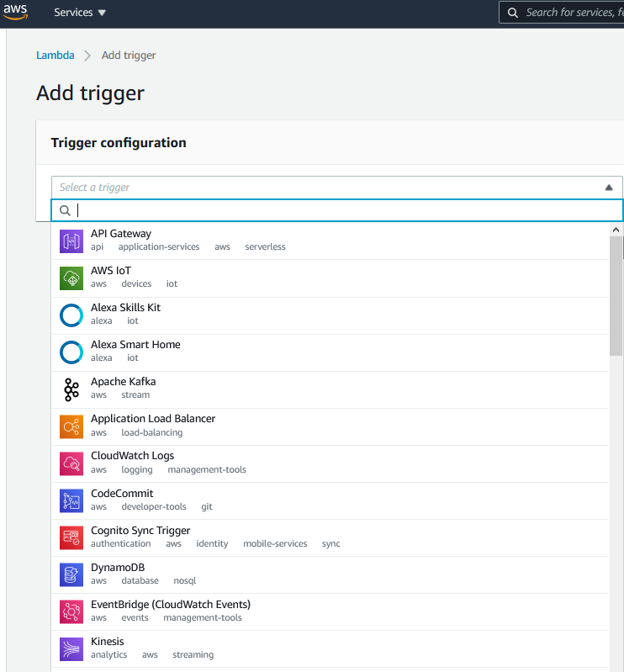
Lambda Function - Triggers

Slide 60
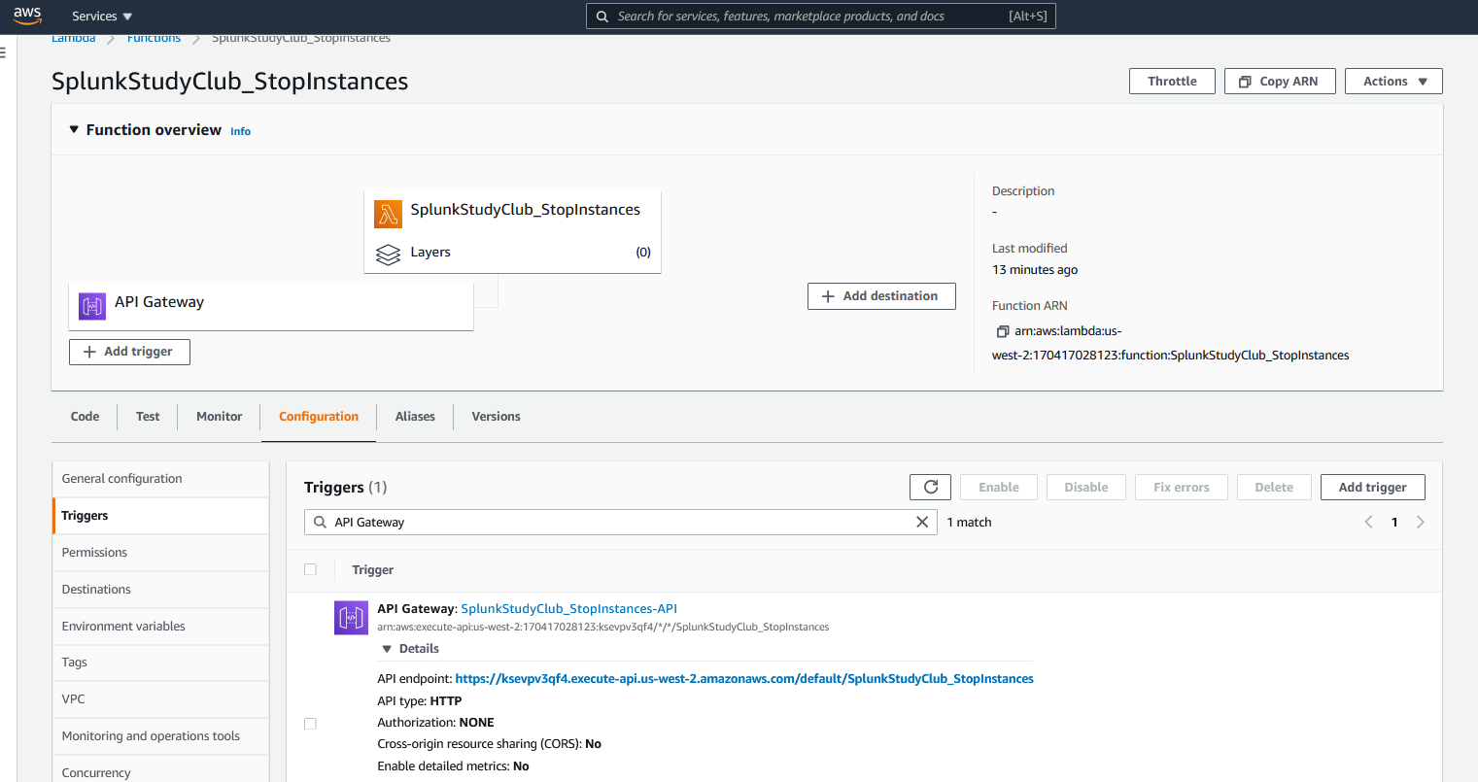
Lambda Function – API Gateway
https://ksevpv3qf4.execute-api.us-west-2.amazonaws.com/default/SplunkStudyClub_StopInstances

Slide 61

AWS Instance Management
SplunkStudyClub
Start
Started
Stop
Stopped
AWS Identity and Access Management (IAM)
https://aws.amazon.com/premiumsupport/knowledge-center/start-stop-lambda-cloudwatch/

Slide 62
Growth Splunk Licensing

Slide 63
Splunk Licenses
Splunk Enterprise Dev/Test license - 50GB
https://www.splunk.com/en_us/resources/personalized-dev-test-licenses.html
Splunk Developer License - 10GB
https://dev.splunk.com/enterprise/dev_license/
Splunk Enterprise License
https://www.splunk.com/en_us/software/splunk-enterprise.html

Slide 64

Splunk Study Club

Slide 65
Thanks!
Any questions?
Aleem Cummins Community Enablement Warrior
Independent
Suman Gajavelly CTO / Co-founder
BitsIO Inc
@aleemcummins https://www.linkedin.com/in/aleemcummins aleem@splunkstudy.club
SplunkTrust Splunk User Group London Splunk Study Club
@sumangajavelly https://www.linkedin.com/in/sumangajavelly suman.g@bitsioinc.com
Fort Worth Splunk User Group
Request your own DNS zone at http://ddns.splunkstudy.club
http://slack.splunkstudy.club
https://github.com/SplunkStudyClub

